Slide 1

Database Systems
Prof. Dr. FERDİ SÖNMEZ
Company Task Organization
İsa Dağ - B2005.010071 - Computer Engineering
Y iğitalp Öztemir- B2105.010112 - Computer Engineering
Ahmet Bedirhan Arvas - B2205.B2005.010018 - Computer Engineering

Slide 2

ABOUT OUR COMPANY
The Task Management System is a software solution developed to optimize our company's project and task management processes. This project enables employees to track their tasks and managers to manage projects more efficiently. The system handles relationships between employees, managers, projects, and tasks, improving workflows and enhancing collaboration. It aims to digitize our business processes, thereby increasing overall productivity.aragraf metniniz

Slide 3
Our Services
Our application assigns a specific project to a specific manager and there can be no other managers of that project
Our application assigns employees to projects and can assign more than one employee to a project
Our application assigns tasks to specific projects and a project can have more than one task.
Our application assigns tasks to employees an employee can be assigned multiple tasks but only one employee can work on a task

Slide 4
GOALS
Optimize Task Tracking
Enhance Project Management
Increase Efficiency
Enable employees to easily track and manage their tasks, ensuring that all assignments are completed on time and with high quality.
Provide managers with powerful tools to plan, execute, and monitor projects, allowing for better resource allocation and project oversight.
Streamline workflows and automate routine processes to reduce administrative overhead and allow employees to focus on more strategic tasks.

Slide 5
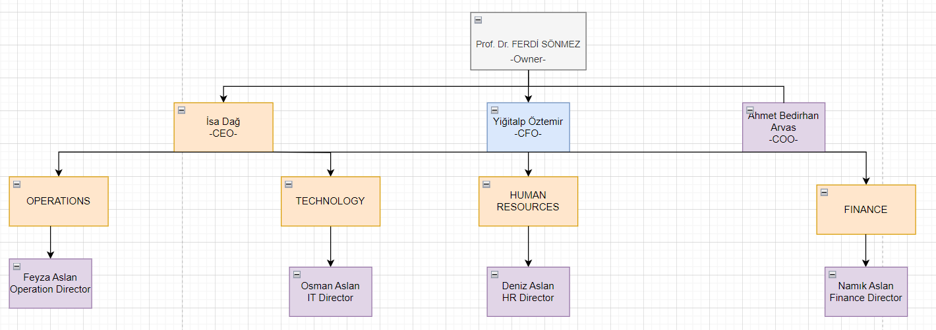
Organizational Chart

Slide 6
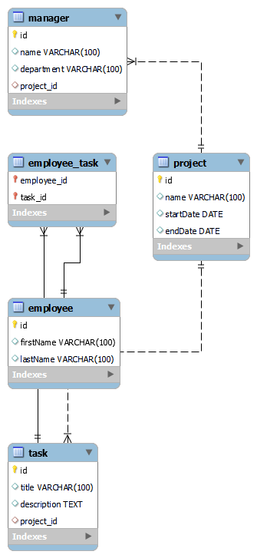
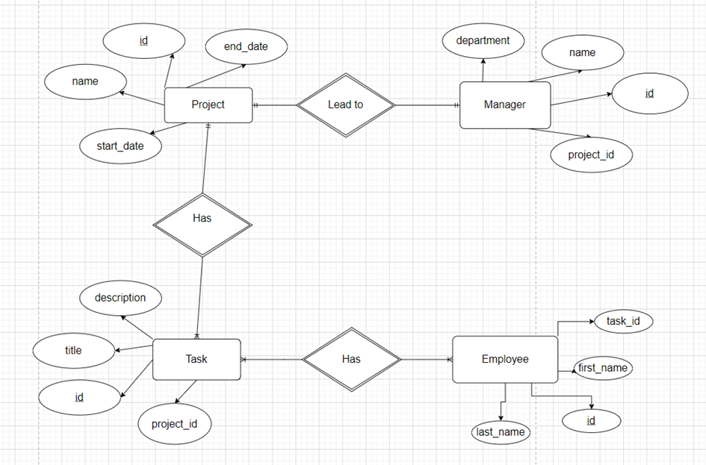
ER Diagrams

Slide 7
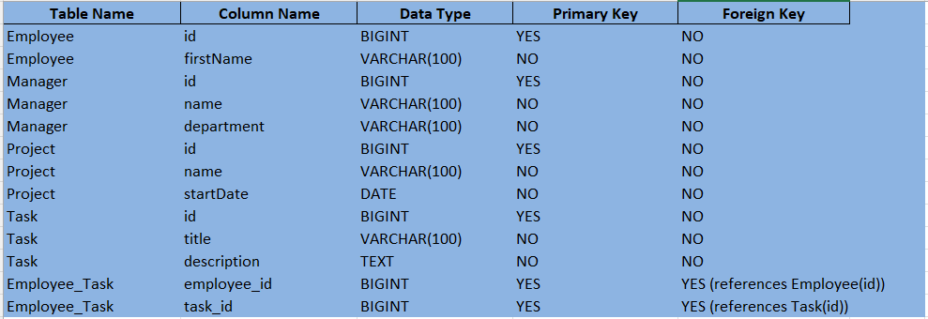
Data Dictionary

Slide 8
Thanks for Listening!

